Slide 1

Streamline Your Workflow: Introducing Team Sync
Team Sync is the centralized hub for modern teams. It integrates key tools for seamless project management. It improves communications and boosts collaboration. It helps teams boost productivity by 30%.
Currently used by 50+ companies, with an average team size of 25.

Slide 2
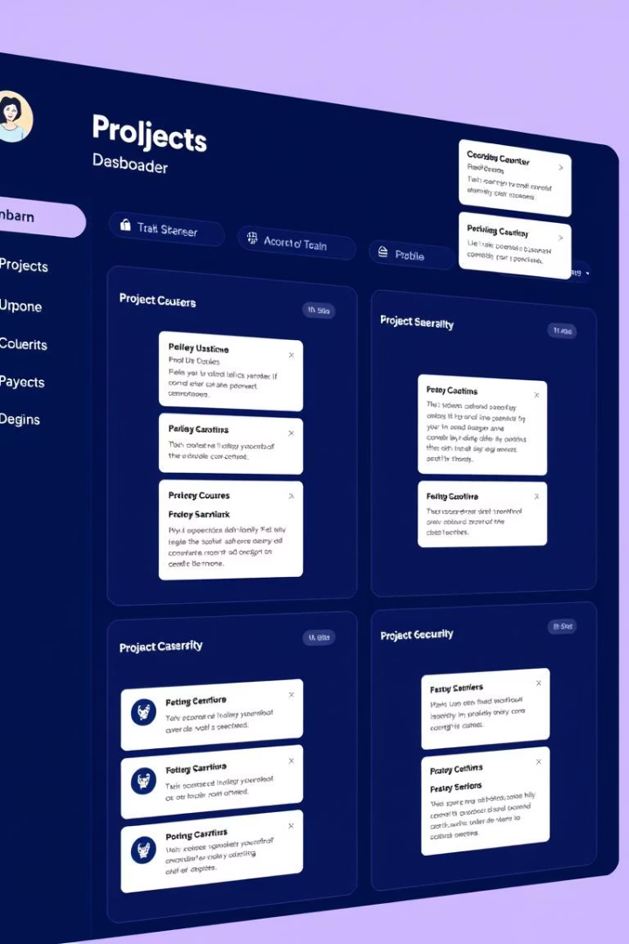
Core Functionality: Projects, Tasks, Teams
Team Sync offers a project dashboard with Kanban boards. Assign tasks, set deadlines, and track progress in real-time. Access a team directory with roles, skills, and contact info. See task completion rate increased by 20%.
Project Dashboards
Real-Time Tracking
Visualize project status.
Monitor progress.
Team Directory
Access skills.

Slide 3
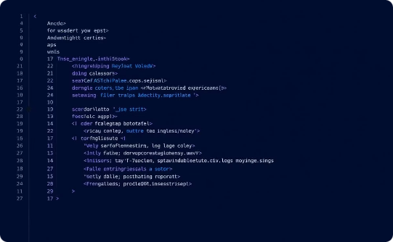
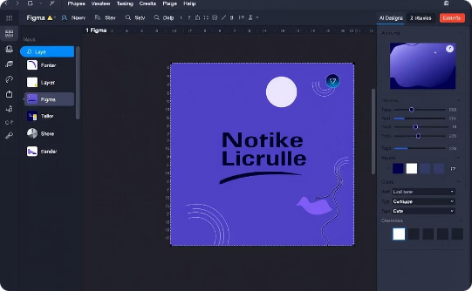

Integrated Editor: Code & Figma
Team Sync features an integrated editor with code and Figma capabilities.
Code Editor
Figma Integration
Collaboration
Edit code with syntax highlighting for Python, JS, and HTML.
Seamless design collaboration with version control and co-editing.
Real-time co-editing and commenting to reduce design signoff time.

Slide 4
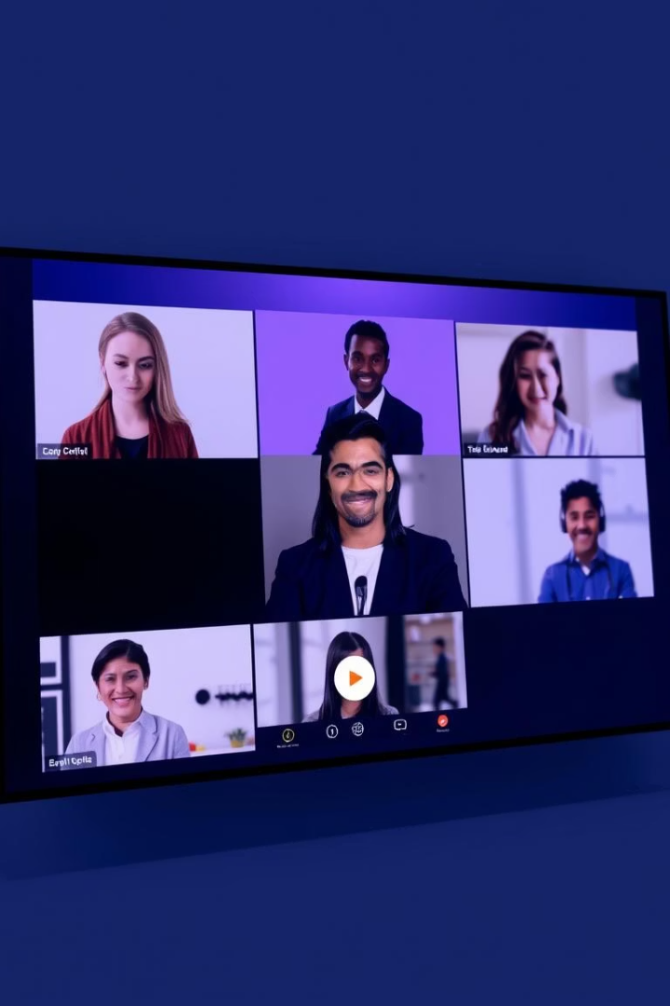



Communication: Integrated Video Calls & Mail
Integrated video conferencing with screen sharing and recording. Internal mail system for secure messaging. Set notifications for project updates, tasks, and mentions. Enjoy a 60% reduction in email clutter.
Video Calls
Internal Mail
Notifications

Slide 5
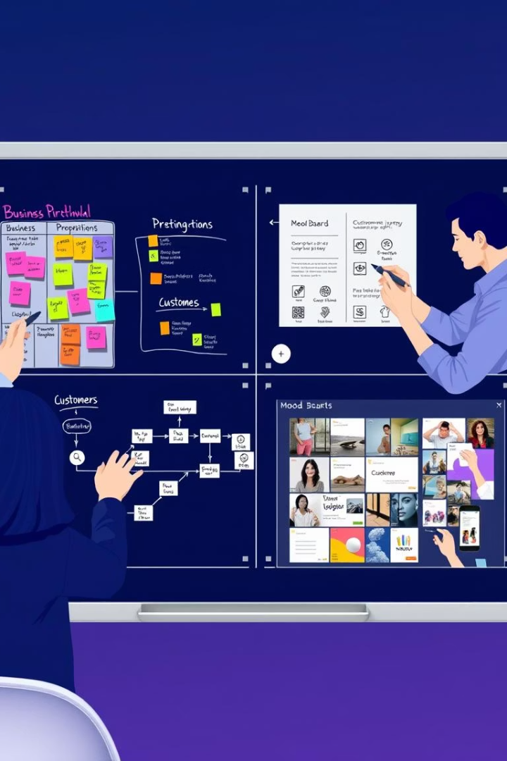
Collaboration: Whiteboard & Document Editing
Real-time collaborative whiteboard for brainstorming. Shared document editing with version history. Supports .docx and .pdf. Commenting, annotations, and approval workflows. Ideation cycle time reduced by 35%.
Whiteboard
Brainstorm ideas.
Doc Editing
Shared documents with approvals.

Slide 6
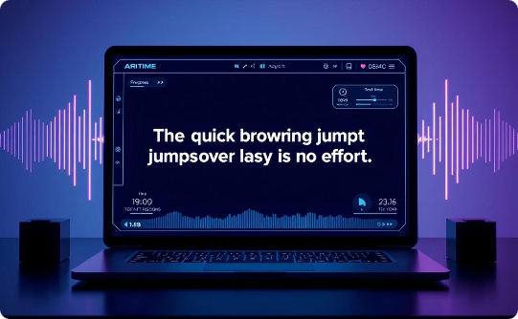
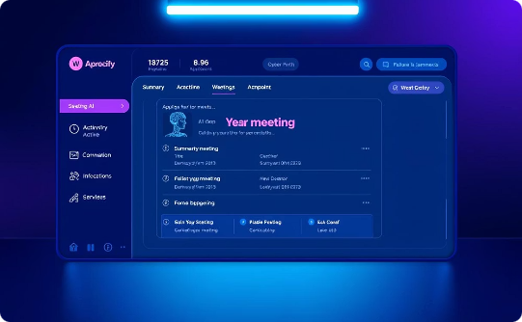
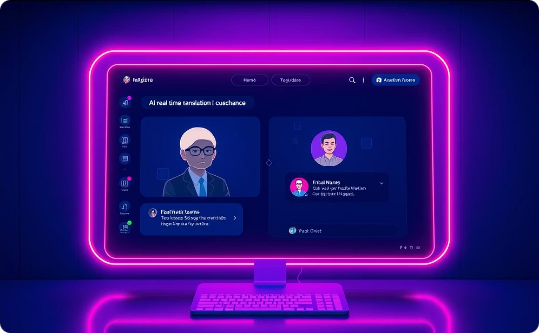
AI-Powered Assistance
Explore our AI-driven features that enhance team productivity and global collaboration. Experience smarter workflows with automatic transcription, AI-generated summaries, and real-time translation.
Transcription
Summaries
Translation
Automated video call transcripts save time and improve accessibility.
AI-generated summaries of meetings and documents provide quick insights.
Real-time translation supports global teams, breaking down language barriers.

Slide 7



Marketing Dashboard: Analytics & Campaigns
Integrated marketing dashboard to track campaign performance. Analytics on website traffic, conversions, and engagement. Tools for managing social media, email marketing, and SEO. See campaign ROI increased by 25%.
2
SEO Tools
Improve search results.
Analytics
1
Track website traffic.
Campaign ROI
3
Analyze the performance.

Slide 8

Robust Security Architecture
Secure authentication with multi-factor options. Granular permissions for controlling access. Protect projects, tasks, and documents. Data encryption at rest and in transit. Compliant with SOC 2, GDPR, and HIPAA.
Authentication
Multi-factor options.
Permissions
Control access.
Encryption
Encrypt all data.

Slide 9



Architecture: React, Node.js, MongoDB
Built on modern tech stack: React, Node.js, and MongoDB. The scalable architecture supports 10,000+ concurrent users. Offers an open API for integrations with other tools. We guarantee 99.9% uptime.
1
Scalable
2
Modern
3
Reliable

